Slide 1


SOFTWARE ENGINEERING (Week-6)
Usama Musharaf
Lecturer (Department of Computer Science)
FAST-NUCES Peshawar

Slide 2
Contents of week # 6
Event Based Software Architecture

Slide 3
Categories of Architectural Styles
Hierarchical Software Architecture
Layered
Data Flow Software Architecture
Pipe and Filter
Batch Sequential
Data Centered Software Architecture
Black board
Shared Repository
Component-Based Software Architecture
Distributed Software Architecture
Client Server
Peer to Peer
REST
SOA
Microservices
Cloud Architecture
Event Based Software Architecture

Slide 4
Event based software architecture

Slide 5
Event driven architecture
Event-driven architecture refers to a system that exchange information between each other through the production and consumption of events.
The main purpose of this type of communication architecture is to provide a decoupling between the event/message, the publishers/producers, and the subscribers/customers.
These are very popular architectures in distributed applications.

Slide 6
Example
Uber’s
Fire Alarming System
Used to enforce integrity constraints in database management systems (called triggers).

Slide 7
Synchronous vs Asynchronous
Synchronous
Asynchronous

Slide 8
Implicit Asynchronous Communication Software Architecture

Slide 9
Implicit Asynchronous Communication Software Architecture
Instead of invoking a procedure directly
A component can announce (or broadcast) one or more events.
When an event is announced, the broadcasting system (connector) itself invokes all of the procedures that have been registered for the event.

Slide 10
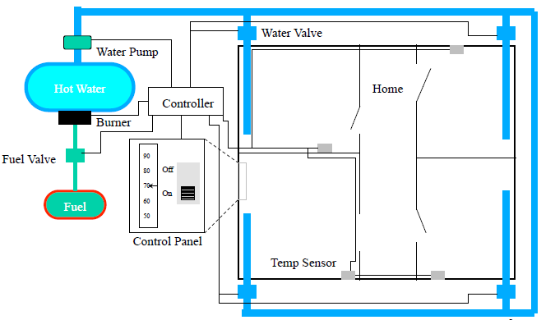

Slide 11
Implicit Asynchronous Communication Software Architecture
Non-buffered Event-Based Implicit Invocations
Buffered Message-Based Software Architecture

Slide 12
Non-buffered Event-Based Implicit Invocations

Slide 13
Non-buffered Event-Based Implicit Invocations
The non-buffered event-based implicit invocation architecture breaks the software system into two partitions:
Event sources and
Event listeners.
The event registration process connects these two partitions. There is no buffer available between these two parties.

Slide 14
Non-buffered Event-Based Implicit Invocations
In the event-based implicit invocations (non-buffered) each object keeps its own dependency list.
Any state changes of the object will impact its dependents.

Slide 15
Benefits:
Reusability of components: It is easy to plug in new event handlers without affecting the rest of the system.
System maintenance and evolution: Both event sources and targets are easy to update.
Parallel execution of event handlings is possible.

Slide 16
Limitations:
It is difficult to test and debug the system since it is hard to predict and verify responses and the order of responses from the listeners.
The event trigger cannot determine when a response has finished or the sequence of all responses.
There is tighter coupling between event sources and their listeners than in message queue-based or message topic-based implicit invocation.

Slide 17
Buffered Message-Based Software Architecture

Slide 18
The buffered message-based software architecture
It breaks the software system into three partitions:
message producers,
Message consumers, and
message service providers.
They are connected asynchronously by either a message queue or a message topic.

Slide 19
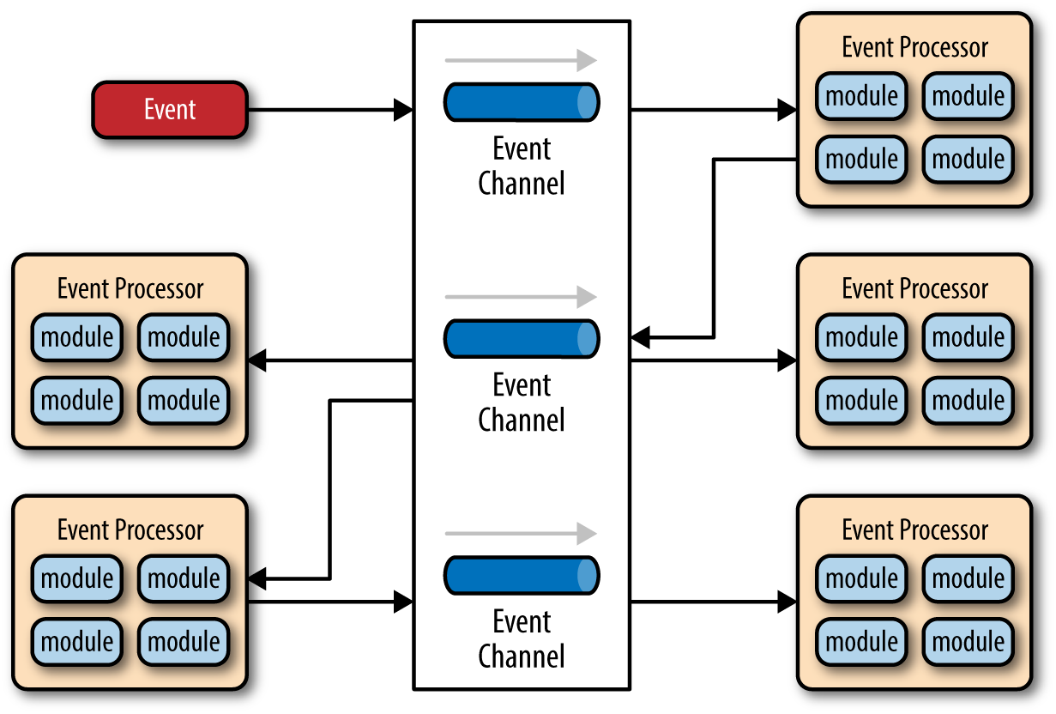
The buffered message-based software architecture

Slide 20
The buffered message-based software architecture
A messaging client can produce and send messages to other clients, and can also consume messages from other clients.
Each client must register with a messaging destination in a connection session provided by a message service provider for creating, sending, receiving, reading, validating, and processing messages.

Slide 21
Applicable domains of message-based architecture:
Suitable for a software system where the communication between a producer and a receiver requires buffered message-based asynchronous implicit invocation for performance and distribution purposes.
The provider wants components that function independently of information about other component interfaces so that components can be easily replaced.

Slide 22
Benefits:
Anonymity: provides high degree of anonymity between message producer and consumer.
Concurrency: supports concurrency both among consumers and between producer and consumers.
Scalability

Slide 23
Benefits
Provides strong support for reuse since any component can be introduced into a system simply by registering it for the events of that system.
Eases system evolution since components may be replaced by other components without affecting the interfaces of other components in the system.

Slide 24
Limitations:
Capacity limit of message queue:
Increased complexity of the system design and implementation.

Slide 25
Limitations
When a component announces an event:
it has no idea how other components will respond to it,
it cannot rely on the order in which the responses are invoked
it cannot know when responses are finished.

Slide 26
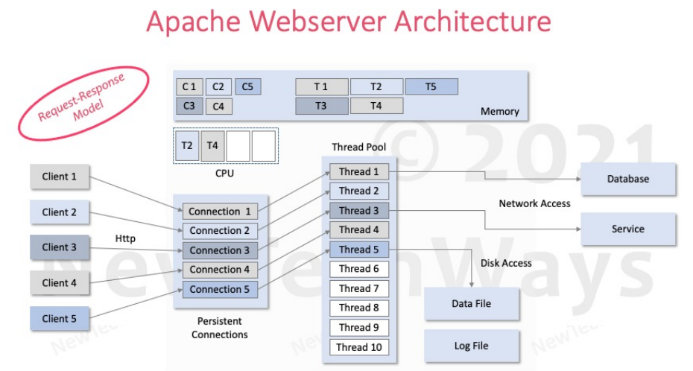

Slide 27
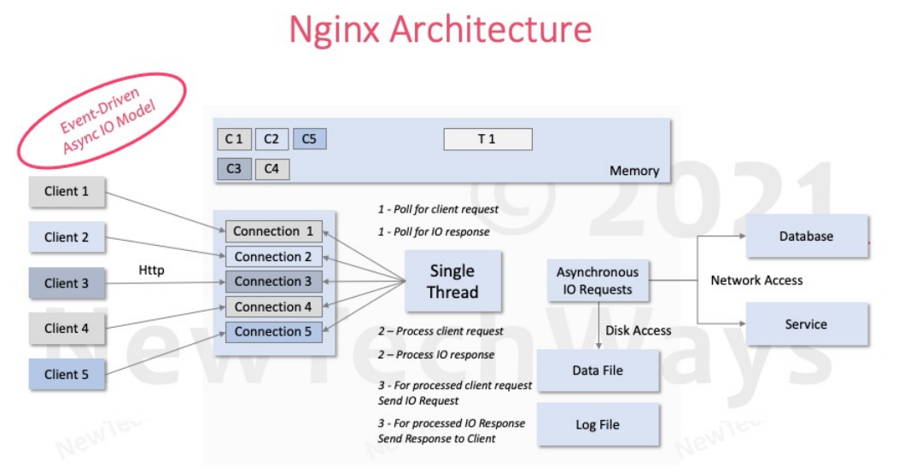

Slide 28
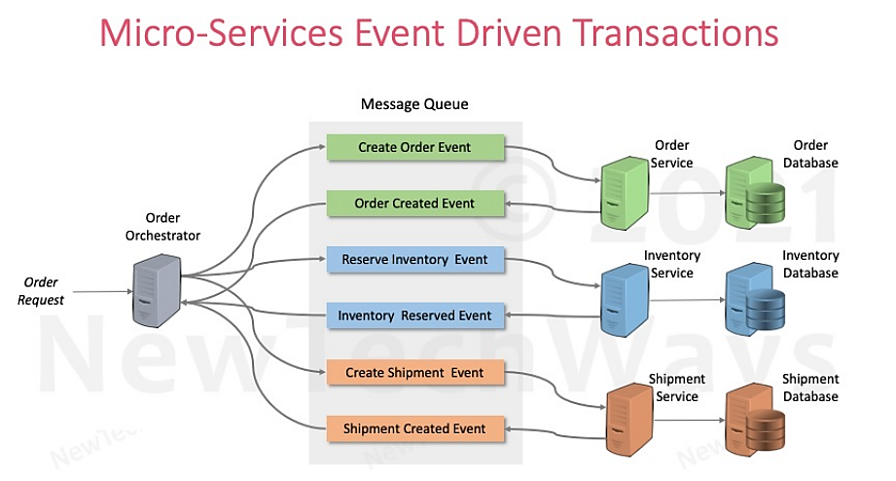

Slide 29
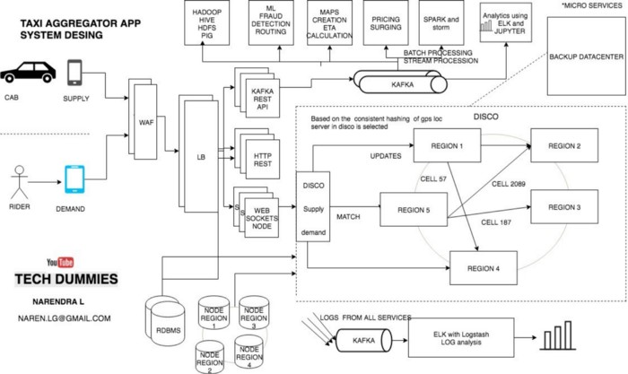

Slide 30
HAVE A GOOD DAY!

